Slide 1
Medical Chatbot Development: Utilizing Knowledge Graph & Machine Learning Techniques
1
19CCE495 : Project phase 2
TEAM ID : ECE013
Project Advisor : Ms.G.Prabha

Slide 2
Team members
2
Name of the student | Roll Number
B.Lakshmikanth Reddy | CB.EN.U4CCE20011
Ch.Sohith Reddy | CB.EN.U4CCE20012
Desu.Sai Tarun | CB.EN.U4CCE20014
Yerabala.Gowtham Kumar | CB.EN.U4CCE20073

Slide 3
OBJECTIVES
3
To implement web scraping techniques to gather related medical data from various sources & data cleaning.
To build a comprehensive medical knowledge graph.
To develop a question-answering system with the developed knowledge graph in integration with the front-end developed website.
To assess the effectiveness of the created chatbot using various metrics.

Slide 4
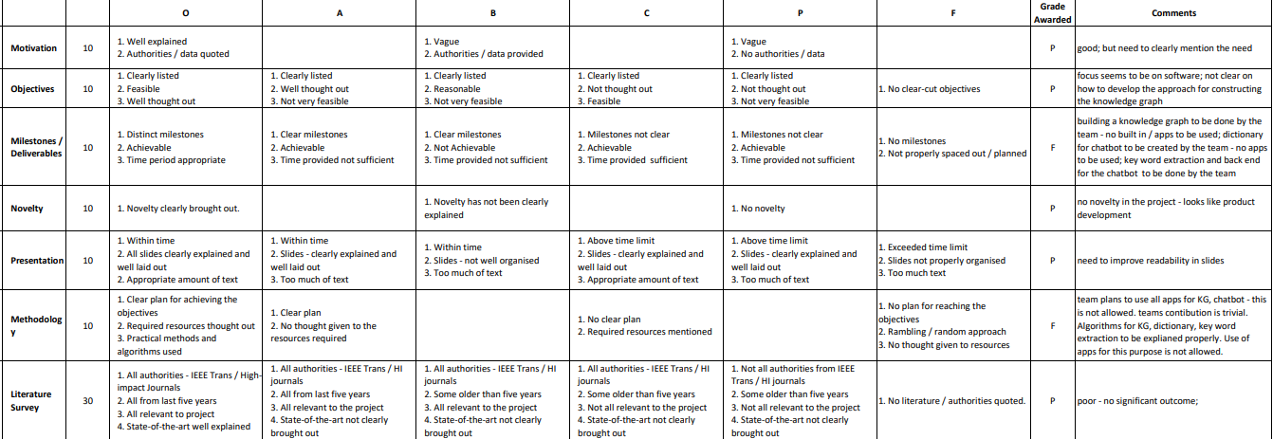
Comments from review1
4

Slide 5
TIME LINE
5
Review | Month | Milestone
1 | Sep 2023 | Literature Survey Data Scraping
2 | Oct 2023 | Data Cleaning & Data Translation
3 | Nov 2023 | Enhancing & testing the knowledge graph Building a baseline structure
4 | Jan 2024 | Integration of chatbot with developed knowledge graph technique
5 | Feb 2024 | Development of front-end website
6 | Mar 2024 | Paper Draft
7 | May 2024 | Draft of Report
8 | Jun/Jul 2024 | Project Completion & Documentation of final report

Slide 6
Literature Survey
6
Title of the paper | Year | Authors | Publication | Comments | Advantages | Drawbacks
A Novel web scraping approach using the additional information obtained from web pages | 2020 | Erdinc Uzun | IEEE Access | How to understand a complicated website. Studies related to different web scraping techniques. Technique used: UzunExt. | Improving time efficiency of data extraction. Exceptional speed will increases. Minimal code overhead. | Handling of Complex HTML Structures. Vulnerability to HTML Changes. Versatility Across Websites.
COVID-Scraper: An Open-Source Toolset for Automatically Scraping and Processing Global Multi-Scale Spatiotemporal COVID-19 Records | 2021 | HAI LAN , DEXUAN SHA ANUSHA SRIRENGANATH MALARVIZHI, YI LIU , YUN LI, NADINE, ZIFU WANG, JINGCHAO YANG , AND CHAOWEI PHIL YANG | IEEE Access | This paper mainly focuses on how to scrap data from different sources dealing with structured and unstructured data | Developed a tools for scraping which is very much flexible and scalable. | The data quality control and validation is not fully automated because accuracy is not guaranteed.

Slide 7
Cont..
7
Title of the paper | Year | Authors | Publication | Comments | Advantages | Drawbacks
A Survey on Knowledge Graphs: Representation, Acquisition, and Applications | 2021 | Shaoxiong Ji , Shirui Pan, Pekka Marttinen , and Philip S. Yu | IEEE TRANSACTIONS ON NEURAL NETWORKS AND LEARNING SYSTEMS | The paper's strength lies in its thorough coverage of recent advancements and emerging trends in knowledge graph research. | Comprehensive Review of Knowledge Graph Research Structured Categorization and Taxonomies | Complexity and Accessibility of Advanced Topics. Potential Lack of Specific Focus.
Research on medical question answering system based on knowledge graph | 2021 | Zhhixue Jiang, Chengying Chi, And Yunyun Ahan | IEEE Access | An explanation which is fully based on knowledge graph & also query Q&A system. An experiment based on Knowledge Graph & Query System. | A Detailed Research on Knowledge graph and question answering system was given. Complete idea about data acquisition and information extraction. | The attribute from the data are very less only drug , symptom and disease names are considered The accuracy of the question and answering system is less

Slide 8
Cont..
8
Title of the paper | Year | Authors | Publication | Comments | Advantages | Drawbacks
Towards electronic health record-based medical knowledge graph construction, completion, and applications: A literature study. | 2023 | Lino Murali a,c , G. Gopakumar b , Daleesha M. Viswanathan c , Prema Nedungadi | Elsevier Journal of Bio medical information's | The use of medical knowledge graphs has the potential to improve healthcare outcomes by extracting new links and hidden patterns from health data sources. Challenges faced during construction of EHR- based knowledge graph | Different approaches of creating medical knowledge graph and their applications. | Some EHR being physical & unstructured can be a challenging in collection of data.
Complex Knowledge Base Question Answering: A Survey | 2022 | Yunshi Lan, Gaole He , Jinhao Jiang, Jing Jiang, Wayne Xin Zhao | IEEE TRANSACTIONS ON KNOWLEDGE AND DATA ENGINEERING | Overview of recent methods in KBQA with a focus on solving complex questions. Key challenges that arise when answering such complex questions. Technique used: SP and IR | SP: Interpretability Robustness Expressiveness IR: Efficiency Flexibility | SP: Difficult to train Computationally expensive IR: Robustness Expressiveness
Design and Development of We-CDSS Using Django Framework: Conducing Predictive and Prescriptive Analytics for Coronary Artery Disease | 2022 | DIVYASHREE N. , (Member, IEEE), AND NANDINI PRASAD K. S., (Senior Member, IEEE) | IEEE Access | This paper is mainly taken into consideration to understand the concepts of Django framework | Accessibility Security features Wide range of in built features and libraries | Learning curve Upgrades and compatibility

Slide 9
Cont..
9
Title of the paper | Year | Authors | Publication | Comments | Advantages | Drawbacks
Question Answering Over Knowledge Graphs: A Case Study in Tourism | 2022 | Sereh Aghaei, Elie Raad, And Anna Fesnel | IEEE Access | Aims to provide answers to natural language questions (NLQs) using KGs. This paper proposes a two-phase approach to QA-KG for small and medium-sized KGs. | More scalable More accurate More flexible | Time-consuming process Over fitting
Knowledge Graph for China’s Genealogy | 2021 | Xindong Wu , Fellow, IEEE, Tingting Jiang Yi Zhu , and Chenyang Bu | IEEE TRANSACTIONS ON KNOWLEDGE AND DATA ENGINEERING | This paper focuses on the development of a genealogical knowledge graph model called Huapu-Kg and utilize genealogical knowledge graphs. | Structured data representation Query and analysis Integration of ai Feasibility validation | Data quality integration Scalability Complexity Expertise requirements
Automated clinical knowledge graph generation framework for evidence based medicine | 2023 | Fakhare Alam a , Hamed Babaei Giglou b , Khalid Mahmood Malik a | Elsevier Journal Expert systems with applications | Proposes a topic specific, PICO enabled, and fully automated framework to curate information and create KG of different clinical domains. | Building a knowledge graph according to the need and the results they are achieved with the PICO framework are remarkable. | The knowledge graph is built according to the two data sets which are considered so they are limited to an extent along with the relations of the KG.

Slide 10
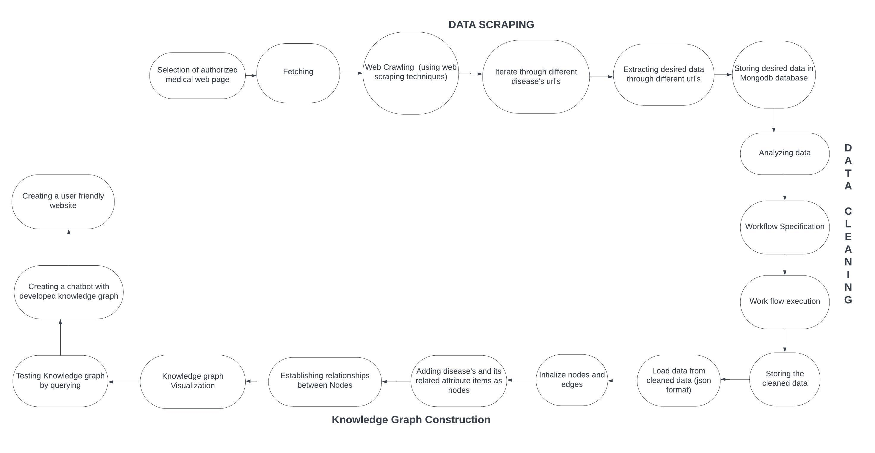
Methodology
10

Slide 11
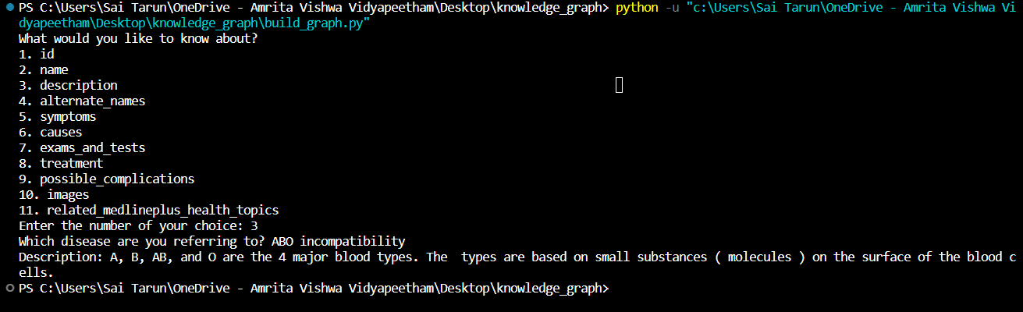
RESULTS
11
Querying :-

Slide 12
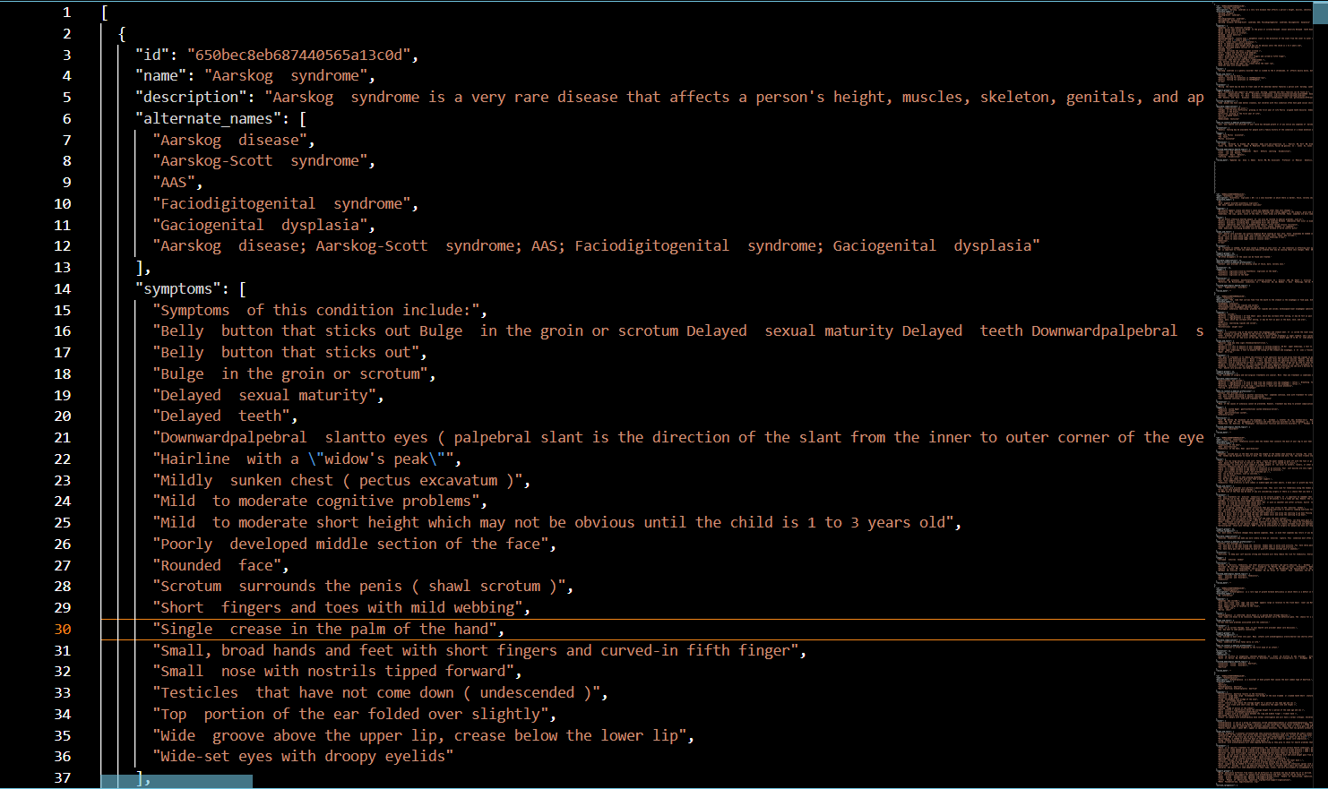
12
Cleaned data :-

Slide 13
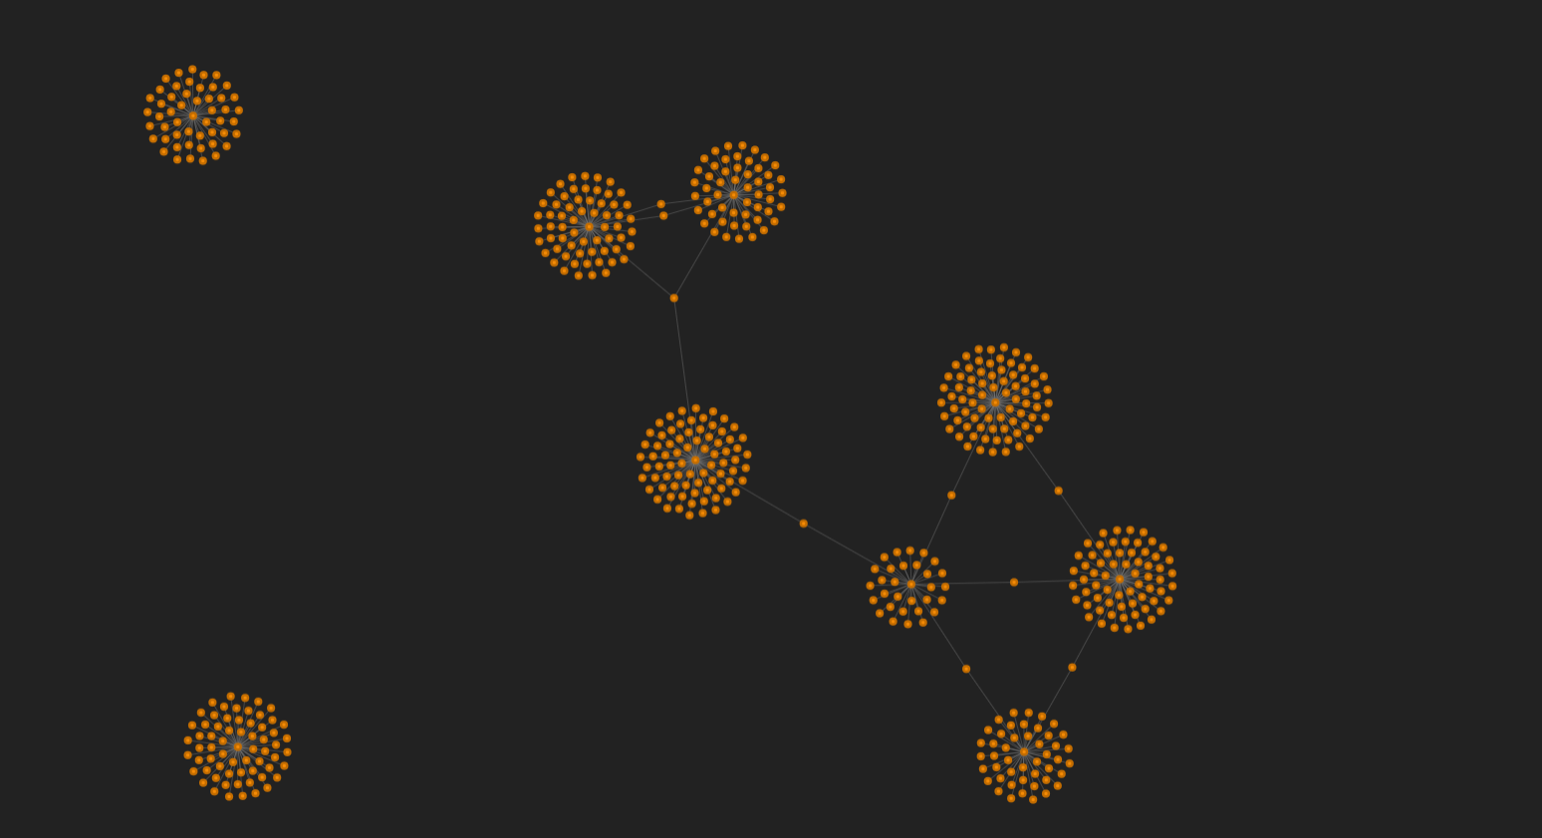
13
Knowledge graph visualization :-

Slide 14
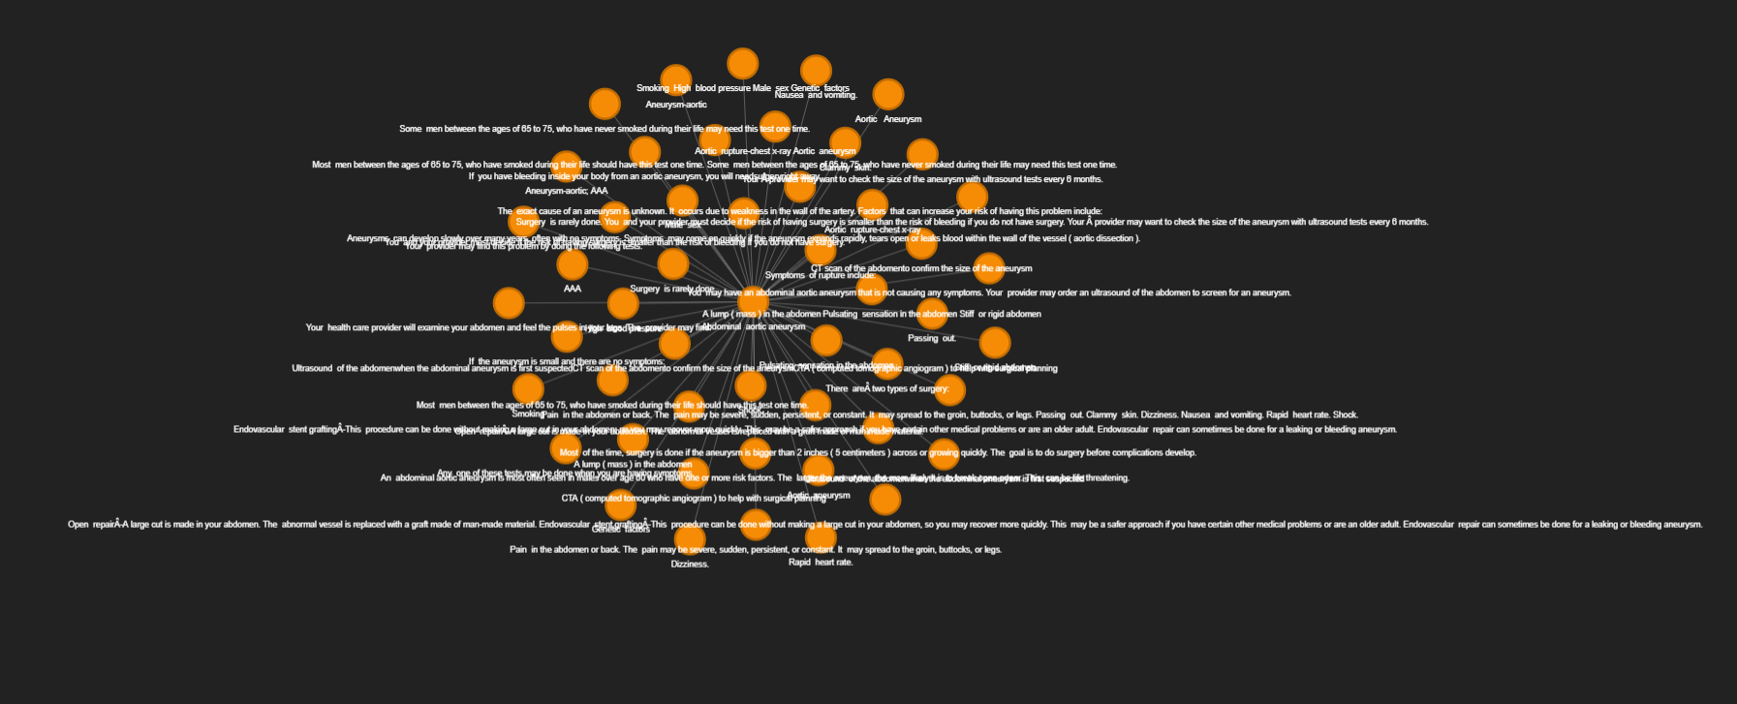
14
Node and edges (Single Node):-

Slide 15
15
LIVE DEMO

Slide 16
References
16
[1]. E. Uzun, "A Novel Web Scraping Approach Using the Additional Information Obtained From Web Pages," in IEEE Access, vol. 8, pp. 61726-61740, 2020, doi: 10.1109/ACCESS.2020.2984503.
[2]. H. Lan et al., "COVID-Scraper: An Open-Source Toolset for Automatically Scraping and Processing Global Multi-Scale Spatiotemporal COVID-19 Records," in IEEE Access, vol. 9, pp. 84783-84798, 2021, doi: 10.1109/ACCESS.2021.3085682.
[3]. S. Ji, S. Pan, E. Cambria, P. Marttinen and P. S. Yu, "A Survey on Knowledge Graphs: Representation, Acquisition, and Applications," in IEEE Transactions on Neural Networks and Learning Systems, vol. 33, no. 2, pp. 494-514, Feb. 2022, doi: 10.1109/TNNLS.2021.3070843.
[4]. Jiang, Zhixue, Chengying Chi, and Yunyun Zhan. "Research on medical question answering system based on knowledge graph." IEEE Access 9 (2021): 21094-21101.
[5]. Lino Murali, G. Gopakumar, Daleesha M. Viswanathan, Prema Nedungadi,Towards electronic health record-based medical knowledge graph construction, completion, and applications: A literature study,Journal of Biomedical Informatics,Volume 143,2023,104403,ISSN 1532-0464
[6]. Y. Lan, G. He, J. Jiang, J. Jiang, W. X. Zhao and J. -R. Wen, "Complex Knowledge Base Question Answering: A Survey," in IEEE Transactions on Knowledge and Data Engineering, vol. 35, no. 11, pp. 11196-11215, 1 Nov. 2023, doi: 10.1109/TKDE.2022.3223858.

Slide 17
References
17
[7]. D. N. and N. P. K. S., "Design and Development of We-CDSS Using Django Framework: Conducing Predictive and Prescriptive Analytics for Coronary Artery Disease," in IEEE Access, vol. 10, pp. 119575-119592, 2022, doi: 10.1109/ACCESS.2022.3220899.
[8]. S. Aghaei, E. Raad and A. Fensel, "Question Answering Over Knowledge Graphs: A Case Study in Tourism," in IEEE Access, vol. 10, pp. 69788-69801, 2022, doi: 10.1109/ACCESS.2022.3187178.
[9]. X. Wu, T. Jiang, Y. Zhu and C. Bu, "Knowledge Graph for China's Genealogy11.A shorter version of this paper won the Best Paper Award at IEEE ICKG 2020 (the 11th IEEE International Conference on Knowledge Graph, ickg 2020.bigke.org).," in IEEE Transactions on Knowledge and Data Engineering, vol. 35, no. 1, pp. 634-646, 1 Jan. 2023, doi: 10.1109/TKDE.2021.3073745.
[10]. Fakhare Alam, Hamed Babaei Giglou, Khalid Mahmood Malik,Automated clinical knowledge graph generation framework for evidence based medicine,Expert Systems with Applications,Volume 233,2023,120964,ISSN 0957-4174.

Slide 18
THANK YOU
18

